Slide 1
Azure Virtual networks (Vnet)
What is a VNet?
An Azure Virtual Network (VNet) is a representation of your own network—in the cloud.
It is a logically isolated segment of the Azure cloud that is dedicated to your subscription.
Key Benefits
Enables secure communication between Azure resources (e.g., VMs, databases, containers).
Functions as a private network, not exposed to the public internet unless you explicitly configure access.
Supports features like subnets, network security groups (NSGs), routing, and peering for advanced configurations.
Notes:
Let’s talk about Azure Virtual Network, or VNet. Think of a VNet as your own private data center in the cloud. It’s not a physical space, but rather a logical isolation of the Azure environment that’s specifically dedicated to your subscription.
This means that all the resources you deploy inside your VNet — like virtual machines, databases, containers, or services — can talk to each other securely and efficiently, just like they would on a private on-premises network.
A key point is that this is a private network, meaning it’s not open to the public internet unless you explicitly configure it to be. This helps significantly with both security and compliance, especially for organizations that handle sensitive data or have strict regulatory requirements.
The VNet enables you to connect different Azure resources — even across regions or subscriptions — and also lets you integrate with your on-premise infrastructure through VPNs or Azure ExpressRoute.

Slide 2










Vnet diagrams
Notes:
This diagram visually breaks down the hierarchy and structure of a Virtual Network — or VNet — within Azure.
Let’s start from the innermost layer. We have Subnets, which are smaller network segments within a VNet. Think of these as isolated lanes of traffic — they allow you to logically group and separate resources, such as separating web servers from databases.
All of these subnets live inside a Virtual Network — the blue box here. This VNet provides internal communication between all subnets, allowing secure, low-latency connections across your Azure services.
Now zooming out a bit, the Virtual Network itself exists within a specific Region — shown in green. A region refers to a physical location where Azure has its data centers. So, a VNet is always tied to a single region.
Finally, the outermost layer is your Subscription — this defines the billing boundary and scope of your Azure resources. Everything — from VNets to VMs — is ultimately billed and managed under this subscription.
This layered model helps isolate workloads, manage security policies, and optimize traffic routing — all while staying under the umbrella of your Azure subscription

Slide 3
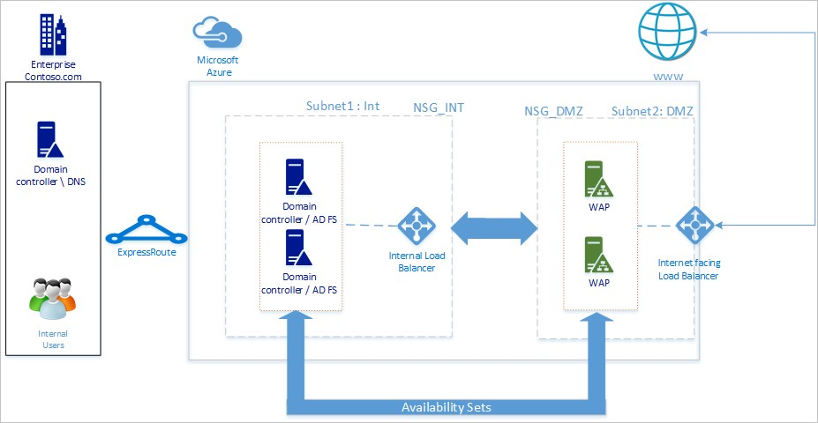
Vnet diagrams
Notes:
This diagram shows a hybrid identity and access management architecture using Azure and on-premises infrastructure. Let's walk through the flow step by step.
On the left, we have the on-premises environment belonging to an enterprise — in this example, 'Contoso.com'. It includes internal users, a domain controller, and a DNS server. This environment connects securely to Azure using ExpressRoute, which provides a private, high-throughput connection — much more secure and reliable than a public VPN.
Moving into the Azure side, you’ll see it’s segmented into two subnets:
Subnet1: Internal (INT) contains domain controllers and Active Directory Federation Services (AD FS) servers. These are responsible for handling identity and authentication requests for internal users. This subnet is protected by a Network Security Group (NSG) labeled NSG_INT, which restricts traffic to and from the subnet based on security rules.
Subnet2: DMZ contains Web Application Proxy (WAP) servers, which act as a bridge between external users (like those accessing from the internet) and internal AD FS services. This subnet has its own security group (NSG_DMZ) and is fronted by an internet-facing load balancer to distribute public traffic.
Between the two subnets is an internal load balancer that routes traffic securely between the WAP servers in the DMZ and the AD FS servers in the internal subnet.
Notice the use of availability sets in both subnets — this ensures high availability and redundancy within each role.
In summary, this architecture enables secure authentication for both internal and external users by combining on-prem identity systems with Azure services, while applying strict network segmentation and load balancing for resilience and performance.

Slide 4
Vnet Capabilities
Isolation
Each Virtual Network (VNet) is logically isolated from other VNets—even within the same region or subscription.
No cross-VNet communication occurs unless you explicitly configure it (e.g., VNet Peering or VPN Gateway).
Customizability
Define your own IP address ranges (CIDRs), subnets, and networking rules.
Create separate VNets for Dev, Test, and Prod—even reusing the same CIDR blocks if isolated by region or subscription.
Connect VNets with different CIDRs to enable secure, controlled communication between environments.
Name Resolution
Azure VNets support internal DNS resolution using Azure-provided DNS servers.
Optionally, you can configure: Custom DNS Servers, DNS Forwarding, Private DNS Zones for enhanced flexibility.
Notes:
First, VNets are isolated by default. This means one VNet cannot communicate with another unless you explicitly set up a connection, like a VNet peering or a VPN. This isolation is critical for implementing security boundaries — for example, keeping production and test environments separate.
Azure VNets are also highly customizable. You can create different VNets for development, testing, and production, and — here’s the interesting part — they can even share the same CIDR block, as long as they’re not connected. This is useful in completely isolated environments, like separate subscriptions or for air-gapped testing.
On the flip side, if you want VNets to communicate — say, between departments or across regions — you can assign different CIDRs and use VNet peering to connect them. This enables shared services or multi-tier application models across VNets.
Lastly, Azure offers built-in DNS resolution for all VNets. You can use Azure’s internal DNS, or replace it with a custom DNS server. This makes it easier to resolve hostnames within your virtual network and support service discovery.

Slide 5
Vnet Capabilities
VNet Peering
VNet connectivity
VNets can be connected to each other.
Any resource can communicate with any other resource even on different Subnets.
App server can connect to database server on different Subnet
Connects VNets across regions for secure communication
Network Security Groups
Internal Routing
Ensures secure communication between resources
Enables communication between resources within a VNet
Subnet Communication
Allows resources in different subnets to communicate
Notes:
First, VNets can be connected to each other using VNet peering. This allows resources in different virtual networks — even in different regions — to communicate securely and with low latency, almost as if they were on the same network.
Within a single VNet, any resource can talk to any other, even if they are in different subnets. There’s no need to configure explicit routing for that — Azure takes care of the internal network routing automatically.
For example, you might have an application server in one subnet and a database server in another. As long as the correct Network Security Group rules are in place, the app server can connect to the database server without needing to go over the internet.
This flexible connectivity model allows you to separate your workloads logically — such as by role, function, or security level — while still keeping them tightly integrated at the network layer.

Slide 6
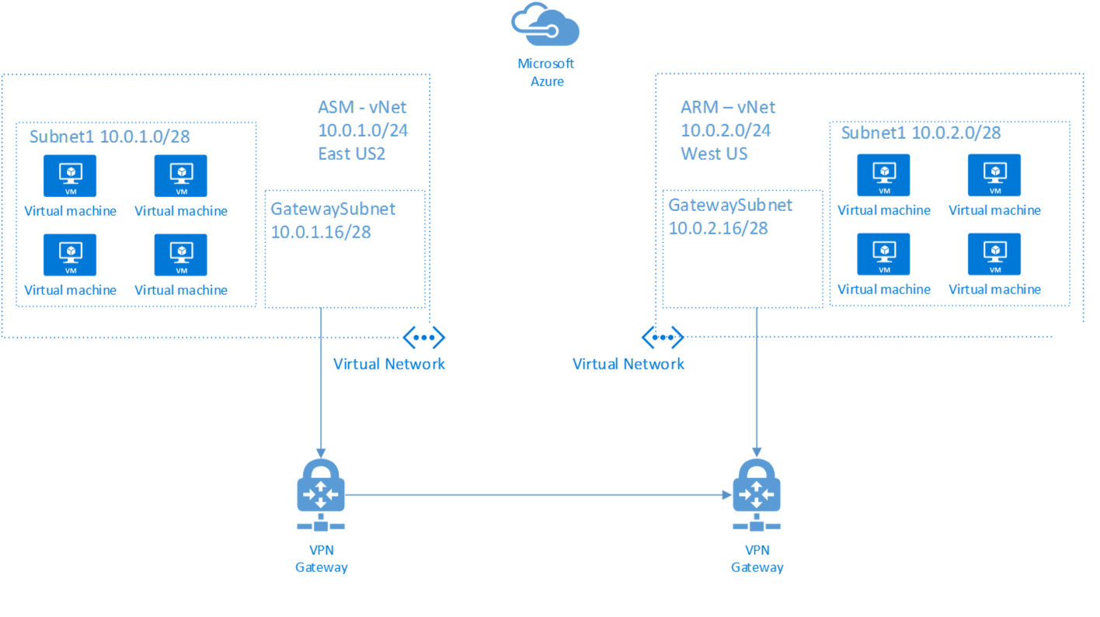
Vnet diagrams

Slide 7
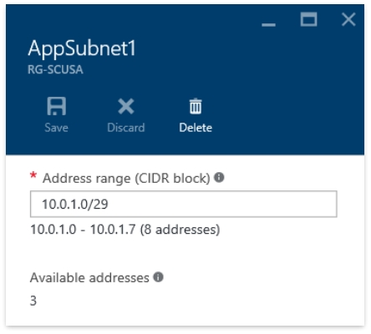
Vnet Reserved IPs
Certain IPs reserved for Azure's internal use
First and last reserved per protocol for host ID and broadcast
The first 3 IP addresses are reserved
Notes:
When you create a subnet in an Azure Virtual Network, not all IP addresses in that subnet range are available for your use — some are automatically reserved by Azure for internal functions.
Let’s break it down:
The first IP address in the range is reserved for the network ID — this identifies the subnet itself.
The last IP address is used for the broadcast address, which isn’t actually used in Azure, but it’s still reserved to maintain compatibility with networking standards.
In addition to those two, three more IP addresses are reserved by Azure:
One for the default gateway,
One for Azure’s internal DNS service (if used),
And one for future internal use.
So in total, the first four IPs and the last IP in any subnet are not usable. For example, if you create a /24 subnet (which has 256 addresses), only 251 of those are available for your virtual machines and other resources.
It’s important to plan for this when designing address spaces, especially in tightly constrained environments or when using small CIDR blocks

Slide 8
Vnet protocol support and limitations
Supported protocols
Blocked protocols
Reserved UDP ports
TCP, UDP, ESP, AH, and ICMP are supported.
Multicast, broadcast, IP-in-IP encapsulated packets, and GRE packets are blocked.
UDP ports 4791 and 65330 are reserved for the host.
DHCP protocol
Unicast support
You can't use Dynamic Host Configuration Protocol via Unicast.
Unicast is supported in virtual networks.
Notes:
In Azure Virtual Networks, there are some important considerations around which network protocols are supported and which are restricted.
Starting with what’s supported — you can use the following TCP/IP protocols within your VNet:
TCP (Transmission Control Protocol)
UDP (User Datagram Protocol)
ICMP (used for tools like ping)
ESP (Encapsulating Security Payload)
AH (Authentication Header)
These are enough to support most typical applications, including web servers, databases, remote administration, and even VPN tunnels using supported protocols.
Now, let’s look at what’s not supported:
Multicast and broadcast traffic are blocked, due to Azure’s virtualized networking model — it’s all Layer 3 (IP-based) routing.
IP-in-IP encapsulation and GRE (Generic Routing Encapsulation) are also not allowed, which means certain custom VPN solutions won’t work unless they use supported tunneling methods.
You also can’t use DHCP over unicast. Specifically, packets using UDP source port 68 and destination port 67 are blocked. Azure handles IP allocation via its own internal DHCP system, and your VMs automatically get IPs assigned from the subnet range.
Lastly, UDP ports 4791 and 65330 are reserved for Azure's internal host operations — you shouldn’t try to use these for your own applications, or you may run into unexpected behavior.
The key message: Azure supports most common traffic types but restricts some low-level or legacy protocols to maintain a secure, performant virtual network environment.

Slide 9
Traffic flow in a VNet
VPN/ExpressRoute
Same VNET
Communication is possible via VPN or ExpressRoute connections.
VMs within the same virtual network subnets can communicate.
Internet Access
Peered VNETs
VMs have default outbound access to anything on the internet.
VMs in peered virtual networks across subnets are able to communicate.
Notes:
Let’s clarify the default connectivity behavior for VMs in an Azure VNet:
Intra‑VNet communication By default, a VM can communicate with *every other VM in every subnet of the same VNet. Azure automatically creates routes such that all subnets within a VNet can talk to each other without additional configuration
Peered VNets When you set up VNet peering—regional or global—by default you allow full connectivity between the VNets. This means VMs in the peered VNet can communicate directly with yours over Microsoft's backbone, with low latency and no gateway involved. For ExpressRoute peering however, connectivity isn't enabled by default—you must explicitly allow it in the gateway settings.
Outbound to the Internet VMs in a VNet have implicit outbound access to the Internet by default. Azure automatically assigns a default outbound IP if no NAT gateway, public IP, or load balancer is configured.
Note: Azure plans to retire this default outbound access for new deployments by September 30, 2025, so we recommend using explicit methods like NAT Gateways.
VPN or ExpressRoute connectivity
If your VNet is connected to on‑premises networks via Azure VPN Gateway or ExpressRoute, outbound and inbound connectivity is enabled by default over those connections. That means VMs can reach on‑prem services and the reverse, once the gateway is provisioned

Slide 10

Traffic flow in a VNet
Not all resources should talk to each other
By default, all subnets within a VNet can communicate — but this may violate security or compliance policies.
Enforce subnet-level boundaries Multi-tier applications (e.g., web ↔ app ↔ database) often require only neighbor tiers to communicate, not full mesh access.
Limit public internet access Outbound internet traffic should be restricted or routed through a controlled egress point like a NAT Gateway or Azure Firewall.
Control specific traffic types and ports Use Network Security Groups (NSGs) to allow only the required protocols and port ranges between subnets or resources.
Notes:
In many real-world architectures, you don’t want blanket connectivity by default—security and compliance often require more controlled access.
Restrict inter-tier communication For example, in a multi-tier application, you may only want the web tier to talk to the application tier, and the application tier to talk to database tier. Allowing unrestricted connectivity between all VMs—like dev to prod—can pose security risks. Use Network Security Groups (NSGs) to explicitly allow only the necessary ports and block everything else.
Limit public outbound access (DMZ scenarios) If you have a DMZ subnet for frontend servers, you might want to prevent them from reaching the internet directly or reaching internal subnets. While Azure allows default outbound access, best practice is to disable it and force explicit egress through a NAT Gateway or an Azure Firewall, and then use NSGs to control the allowed outbound ports and
Control traffic type & source/destination You can finely tailor traffic: for instance, allow only TCP port 443 from the web subnet to the app subnet, and only SQL port 1433 from app to DB subnet. NSGs let you filter on five-tuple (protocol, source, destination, ports). With default NSG rules in place, you can then add deny rules at higher priority to block unwanted traffic paths .

Slide 11
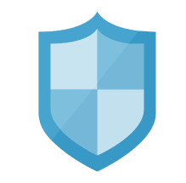
Network security groups
NSGs act as rule containers Create custom security rules and group them in a Network Security Group (NSG).
Assign NSGs to Subnets, NICs, or Both NSGs can be applied at:
The subnet level (affects all VMs in the subnet)
The network interface (NIC) level (affects that specific VM)
Or both — combined enforcement applies
Subnet NSGs are not perimeter firewalls Rules are evaluated at the NIC level, even when applied to a subnet. Every NIC enforces the rules as if they were local.
Rule evaluation order
Inbound traffic: Subnet NSG → then NIC NSG
Outbound traffic: NIC NSG → then Subnet NSG ➤ Both must allow the traffic for it to pass.
Notes:
Applying an NSG at subnet level actually configures a set of rules that each VM enforces — it's not a single perimeter gate. If you attach another NSG to a NIC, both NSGs must permit traffic, which allows for layered, defense-in-depth security.
Apply NSGs to subnets for broad, consistent coverage.
Use NIC-level NSGs only for special cases needing tighter controls. This avoids scattered rule management.
Understand the two-stage evaluation model to prevent unintentional blocking of traffic.

Slide 12


NSG Rules
1. Source
IP address, CIDR range, Service Tag (e.g., Internet, VirtualNetwork), or Application Security Group (ASG)
2. Source Port
A specific port (e.g., 80), range (1000–2000), or * for all ports
3. Destination
IP, CIDR, Service Tag, or ASG — just like Source
4. Destination Port
Exact port, range, or wildcard
5. Protocol
TCP, UDP, ICMP, ESP, AH, or * to match all
Notes:
Priority & Action
Priority level (100–4096) determines rule evaluation order—lower numbers are higher priority . Once traffic matches a rule, evaluation stops—subsequent rules are ignored.
Action is a simple Allow or Deny directive.
How It Works
NSGs are stateful, meaning once an outbound connection is allowed, return traffic is automatically permitted.
You cannot create two identical priority + direction rules—Azure enforces unique rule numbers
Real‑World NSG Rule Example
Suppose you want to allow SSH only from a specific office IP, but block all other SSH requests:
Deny rule at priority 100: Source: *, Source port: *, Destination: your VM’s IP, Destination port: 22, Protocol: TCP
Allow rule at priority 110: Source: OfficeIP/32, Destination: <VM IP>, Port 22, Protocol: TCP
Because the Deny rule has higher priority, it will block all traffic before the Allow rule applies—so you’d invert priority: Allow 100 first, then Deny at 110
Key Takeaways
Rules match on [source, source port, dest, dest port, protocol].
Evaluation is priority-based, stopping at first match.
NSGs are stateful, so explicit return rules aren’t needed.
Custom rules override Azure’s default ones, which have the lowest priority (65000+)

Slide 13
NSG Rule Scope with CIDR & Tags
Source/Destination can be defined using:
IP Addresses (e.g., 10.0.0.4)
CIDR Blocks (e.g., 10.0.0.0/24)
Service Tags (Predefined Labels)
Common Azure Service Tags
Tag | Description
VirtualNetwork | Matches all addresses within the same VNet (incl. Subnets)
AzureLoadBalancer | Refers to Azure’s Internal Load Balancer Infrastructure
Internet | Represents all External IPs (outside the VNet address space)
Notes:
Azure NSG rules match traffic using the five-tuple plus CIDR ranges, so you can define source/destination IPs in CIDR notation (e.g., 10.0.0.0/24) to match single addresses or entire ranges.
Beyond explicit CIDR prefixes, Azure also provides three built-in service tags that streamline defining common traffic scopes:
VirtualNetwork
Represents your entire VNet address space, including any peered VNets, on-premises networks connected via VPN/ExpressRoute, the Azure host IP (168.63.129.16), and user-defined routes. This means a rule using this tag can match much more than just the local subnet or VNet.
AzureLoadBalancer
Matches Azure’s own infrastructure load balancer, specifically the health probe IP (168.63.129.16). This allows your VM or resource to accept load-balancer health checks.
Internet
Covers any public IP space—essentially anything outside your VNet. This tag includes Azure public IP ranges too. Use this to define rules for internet-bound or external traffic .

Slide 14
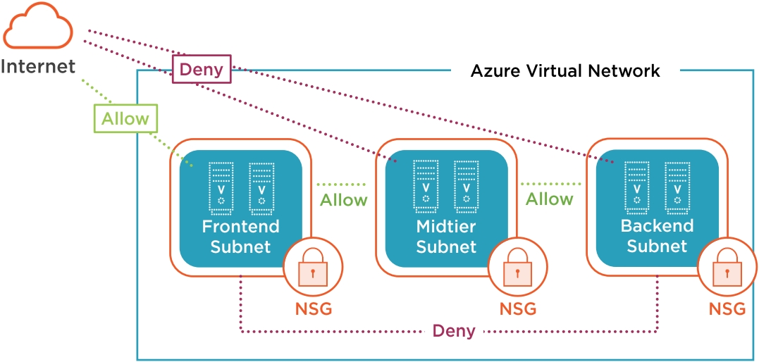
NSG Example
Notes:
On this slide, we’re looking at a typical Azure Virtual Network setup, segmented into three main subnets: the Frontend, Midtier, and Backend subnets. Each of these subnets contains two virtual machines, which represent the compute resources deployed in each layer of the application architecture.
The key focus here is on how traffic is managed and secured using Network Security Groups, or NSGs. These NSGs act as virtual firewalls, controlling inbound and outbound traffic to the resources within each subnet.
Starting with the Frontend Subnet, it’s directly connected to the internet. You’ll notice green 'Allow' and red 'Deny' indicators showing which types of traffic are permitted or blocked. Typically, we allow HTTP/HTTPS traffic from the internet to the frontend VMs, while denying other types of access for security.
The Midtier Subnet is isolated from the internet but can communicate with the Frontend Subnet. This is where application logic might reside, and NSGs ensure that only traffic from the Frontend Subnet is allowed in.
Finally, the Backend Subnet is the most restricted. It only accepts traffic from the Midtier Subnet, typically for database access or internal services. No direct internet or frontend access is allowed here, which is a best practice for securing sensitive data.
This layered approach to network segmentation and access control helps enforce the principle of least privilege and enhances the overall security posture of the cloud environment

Slide 15
NSG Example
Rules are combined in a NSG
Based on the priority flexible configurations are possible
Lower priority number means higher priority
Notes:
Azure Network Security Groups combine multiple custom and default rules into a single organized ruleset. Here's how it works:
Rules are ordered by priority, which is a numeric value ranging from 100 (highest) to 4096 (lowest).
When network traffic flows into or out of a VM (via its NIC) or subnet, Azure evaluates NSG rules in ascending priority order—meaning lower numbers are processed first
Once a rule matches—based on the source, destination, protocol, and port—the specified action (Allow or Deny) is immediately applied, and no further rules are checked

Slide 16
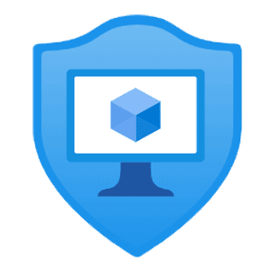
Application security groups
Simplify NSG Management in Dynamic Environments
NSGs traditionally rely on IP address ranges, which can be hard to manage as environments grow.
Application Security Groups (ASGs) let you group VMs logically by role:
Example groups: Web, App, Database
Each VM NIC can be assigned to one or more ASGs.
You can reference ASGs in NSG rules instead of IPs or CIDRs.
ASGs work alongside NSG features like service tags and priority rules.
Notes:
Managing fine‑grained security using IP ranges in large VNets quickly becomes difficult. That’s where Application Security Groups (ASGs) come in—they let you group NICs of VMs by function (like Web, DB, or WebApp) and reference those groups in NSG rules instead of explicit IP ranges.
How ASGs work:
You create an ASG for each role or application tier—e.g., ASG-Web, ASG-DB.
You assign each VM’s NIC to one or more ASGs—it becomes a logical member of those roles .
In your NSG, you use ASGs in rules. For example, allow traffic from ASG-Web to ASG-DB on port 1433. The NSG still supports all features—like service tags and CIDR ranges .
Why use ASGs?
Simplification & scalability: No need to maintain complex IP-based rules as you scale—just assign the VM NIC to the correct ASG.
Consistent security policy at scale: One NSG can cover multiple subnets or roles while maintaining clarity via ASG tags.
Micro-segmentation & least privilege: You can restrict traffic precisely between roles (e.g., Web → App, App → DB) .

Slide 17
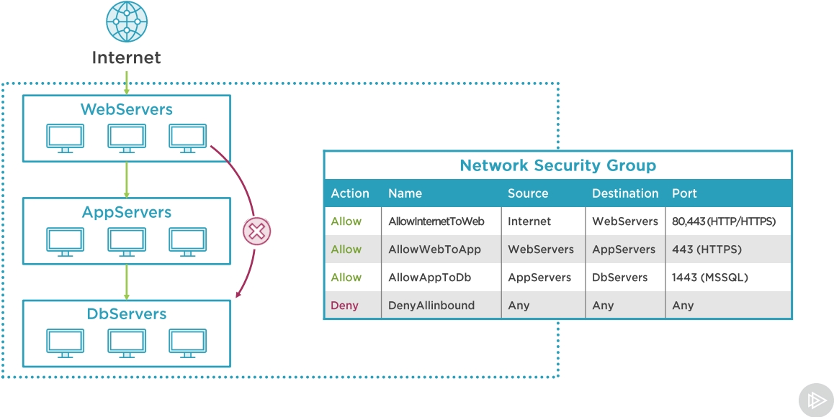
ASG Example
Notes:
This slide illustrates how we can use Application Security Groups (ASGs) in combination with Network Security Groups (NSGs) to manage traffic flow securely and efficiently within our Azure environment.
We have three main server groups represented here:
WebServers: These are exposed to the internet and handle incoming HTTP and HTTPS traffic.
AppServers: These handle internal application logic and communicate only with the WebServers.
DbServers: These store data and are only accessible by the AppServers.
The table on the right outlines the NSG rules applied to control traffic:
AllowInternetToWeb: This rule allows HTTP (port 80) and HTTPS (port 443) traffic from the internet to the WebServers.
AllowWebToApp: This permits secure HTTPS traffic (port 443) from WebServers to AppServers.
AllowAppToDb: This allows SQL traffic (port 1443) from AppServers to DbServers.
DenyAllInbound: This is a default rule that blocks all other inbound traffic not explicitly allowed.
By using ASGs, we can assign VMs to logical groups like WebServers, AppServers, and DbServers. This makes our NSG rules more readable and scalable, especially in dynamic environments where IP addresses change frequently.
This setup enforces a zero-trust model, where each layer only communicates with the next layer as needed, minimizing the attack surface and improving overall security.

Slide 18
Pop quiz:
Scenario: VNet-EastUS (10.1.0.0/24) is peered with VNet-WestEurope (10.2.0.0/24). You want only DB servers in WestEurope to talk to App servers in EastUS—nothing else should cross the peering.
What is the simplest and most secure way to enforce this?
A. Deploy Azure Firewall in EastUS to filter peered traffic B. Use “Block traffic to remote VNet” on WestEurope peering + NSG allow only DB subnet C. Apply NSG on EastUS subnet allowing only 10.2.0.0/24 → 10.1.0.0/24 D. Use User Defined Route to drop all remote VNet IP ranges except the DB subnet

Slide 19
Pop quiz:
Scenario: VNet-EastUS (10.1.0.0/24) is peered with VNet-WestEurope (10.2.0.0/24). You want only DB servers in WestEurope to talk to App servers in EastUS—nothing else should cross the peering.
What is the simplest and most secure way to enforce this?
A. Deploy Azure Firewall in EastUS to filter peered traffic B. Use “Block traffic to remote VNet” on WestEurope peering + NSG allow only DB subnet C. Apply NSG on EastUS subnet allowing only 10.2.0.0/24 → 10.1.0.0/24 D. Use User Defined Route to drop all remote VNet IP ranges except the DB subnet
Notes:
You can disable full connectivity by setting “Block traffic to remote VNet” on WestEurope peering, then selectively allow the DB subnet via NSG—minimal setup, no firewall required

